Slide 1

VA ORD/Operation Warp Speed/NIAID Collaboration:
ACTIV-2 Study
Overview, Registration and Activation
Dial in (Main): (562) 247-8321
Dial in (Alt): (646) 307-1722
Attendee Access Code: 769-418-758
Slides in “Handout” Tab
VA Office of Research & Development
October 16, 2020

Slide 2
Acronyms
ACTG | AIDS Clinical Trials Group
ACTT-1 | Adaptive COVID-19 Treatment Trial-1
ACTIV | Accelerating COVID-19 Therapeutic Interventions and Vaccines
CRS | Clinical research site
CSP | Cooperative Studies Program
CSPCC | Cooperative Studies Program Coordinating Center
DC VAMC | Washington DC VA Medical Center
FCOI | Financial Conflict of Interest
ICC | International Coordinating Center
mAb | Monoclonal antibody
NIAID | National Institute of Allergy and Infectious Diseases, NIH
NP | nasopharyngeal
NPC | Non-profit corporation
OWS | Operation Warp Speed
SCC | Site Coordinating Center
VAMC | VA Medical Center
VA OI&T | VA Office of Information and Technology
VA ORD | VA Office of Research and Development

Slide 3
PRESENTERS
Victoria Davey, PhD, MPH – Associate CRADO for Epidemiology and Public Health, VA network lead for ACTIV studies
H. Clifford Lane, MD - NIAID Deputy Director for Clinical Research and Special Projects
Janet Woodcock, MD – Therapeutics Lead, Operation Warp Speed and Director of the Center for Drug Evaluation and Research (CDER) at the Food and Drug Administration (FDA)
David (Davey) M. Smith, MD, MAS, FACP, FIDSA – VA San Diego and Chief, Division of Infectious Diseases and Global Public Health, Professor of Medicine, University of California San Diego
Donna Kostandy – Associate Director, Strategic Site Collaborations, PPD
Cristin Harrington – Deputy Director, Perry Point Cooperative Studies Program Coordinating Center (CSPCC), and Coordinator, INSIGHT VA CSP Site Coordinating Center (VA CSP SCC)
Rhonda Henry – Vice President, Patient Centered Trials, PPD

Slide 4
Introduction
VA has raised its hand to contribute to national and international studies on COVID-19 since the beginning of the pandemic
Accelerating COVID-19 Therapeutic Interventions and Vaccines (ACTIV) and Operation Warp Speed (OWS) are U.S. government initiatives to enable development of diagnostics, therapeutics, and vaccines
Getting OWS/ACTIV protocols launched at VA sites is the highest priority in ORD’s COVID-19 portfolio
Providing veterans with access to OWS/ACTIV clinical trials is a goal of our VHA Executive in Charge, Dr. Richard Stone
“..our clinical research capabilities and experience make us a premier environment for conducting these important studies” (Richard Stone, VHA USH Announcements, emailed 8/19/20)
Notes:
OWS goal: to rapidly fund, coordinate, and offer regulatory support to enable the rapid development and distribution of novel diagnostics, therapeutics, and vaccines for COVID-19
Partners:
Department of Health & Human Services
Centers for Disease Control and Prevention (CDC)
Food and Drug Administration (FDA)
National Institutes of Health (NIH)
Biomedical Advanced Research and Development Authority (BARDA)
Department of Defense (DoD)
Department of Agriculture
Department of Energy
Department of Veterans Affairs
Pharma/Industry

Slide 5
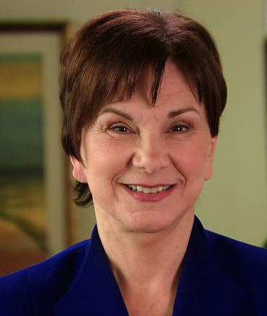

WELCOME REMARKS
Janet Woodcock, MD
Therapeutics Lead, Operation Warp Speed; Director of the Center for Drug Evaluation and Research (CDER) at the FDA
H. Clifford Lane, MD
NIAID Deputy Director for Clinical Research and Special Projects
Notes:
OWS goal: to rapidly fund, coordinate, and offer regulatory support to enable the rapid development and distribution of novel diagnostics, therapeutics, and vaccines for COVID-19
Partners:
Department of Health & Human Services
Centers for Disease Control and Prevention (CDC)
Food and Drug Administration (FDA)
National Institutes of Health (NIH)
Biomedical Advanced Research and Development Authority (BARDA)
Department of Defense (DoD)
Department of Agriculture
Department of Energy
Department of Veterans Affairs
Pharma/Industry

Slide 6
OBJECTIVES
Provide key information about ACTIV-2 and other ACTIV studies available to VAMC sites in fall 2020
Describe ACTIV-2: a key Operation Warp Speed (OWS) initiative, enrolling outpatient COVID-19 participants to assess multiple investigational neutralizing SARS-CoV-2-specific monoclonal antibodies
Describe the VA ORD/ OWS/ NIAID collaboration, structure, governance, and communication processes
Describe the objectives, design, methods and endpoints of ACTIV-2
Describe the processes for registration and study activation for VAMC sites for ACTIV-2
Provide an opportunity for questions and comments

Slide 7
ACTIV STUDIES
ACTIV Study | Description | VA ORD Coordination* | Status
ACTIV-1 | Phase 3 – Inpatient master protocol to study immune modulators in COVID positive patients | No | enrolling
ACTIV-2 | Phase 3 –Outpatient master protocol to study monoclonal antibodies and other therapies in COVID positive patients | Yes | enrolling
ACTIV-3 | Phase 3 –Inpatient master protocol to study monoclonal antibodies and other therapies in COVID positive patients | Yes | enrolling
ACTIV-4 | Phase 3 – Master protocol to study antithrombotic therapies in COVID positive patients | No | enrolling
ACTIV-5 | Phase 2 – Inpatient master protocol to study immune modulators, antivirals, and others for early large effects in COVID positive patients | No | development
*VA sites may choose to join; ORD support will be limited

Slide 8
ACTIV-2: OVERVIEW – Dr. Davey Smith

Slide 9

Adaptive Platform Treatment Trial for Outpatients with COVID-19
(Outpatient monoclonal antibodies and other therapies)
Adapt Out COVID
ACTIV-2 / A5401
A Multicenter Trial of the AIDS Clinical Trials Group (ACTG) and the Accelerating COVID-19 Therapeutic Interventions and Vaccines (ACTIV) partnership

Slide 10


Rapidly and efficiently evaluate multiple potential therapeutics for COVID-19 in an outpatient setting

Slide 11


Randomized, blinded, controlled platform that allows agents to be added and dropped during the study

Slide 12

Randomized, blinded, controlled platform that allows agents to be added and dropped during the study
Begins with phase II followed by a larger phase III for promising agents

Slide 13

Randomized, blinded, controlled platform that allows agents to be added and dropped during the study
Begins with phase II followed by a larger phase III for promising agents
When two or more new agents are being tested concurrently, the same placebo will be used, if feasible

Slide 14




Prioritized based on:
Activity against SARS CoV-2 entry or replication
Phase I pharmacokinetic and safety data
Potential to expand to Phase III if found effective

Slide 15
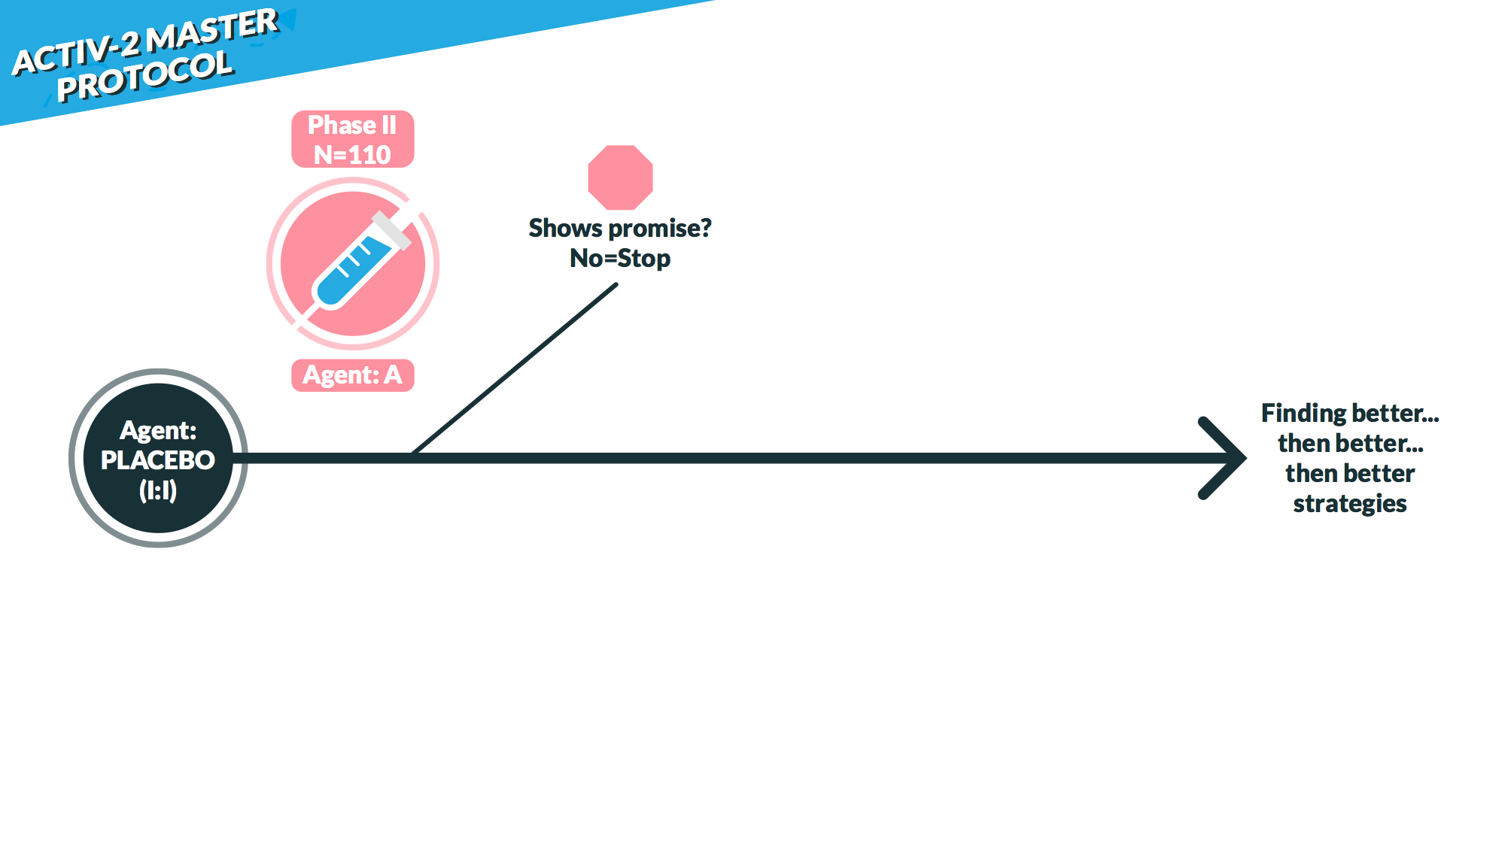

Slide 16
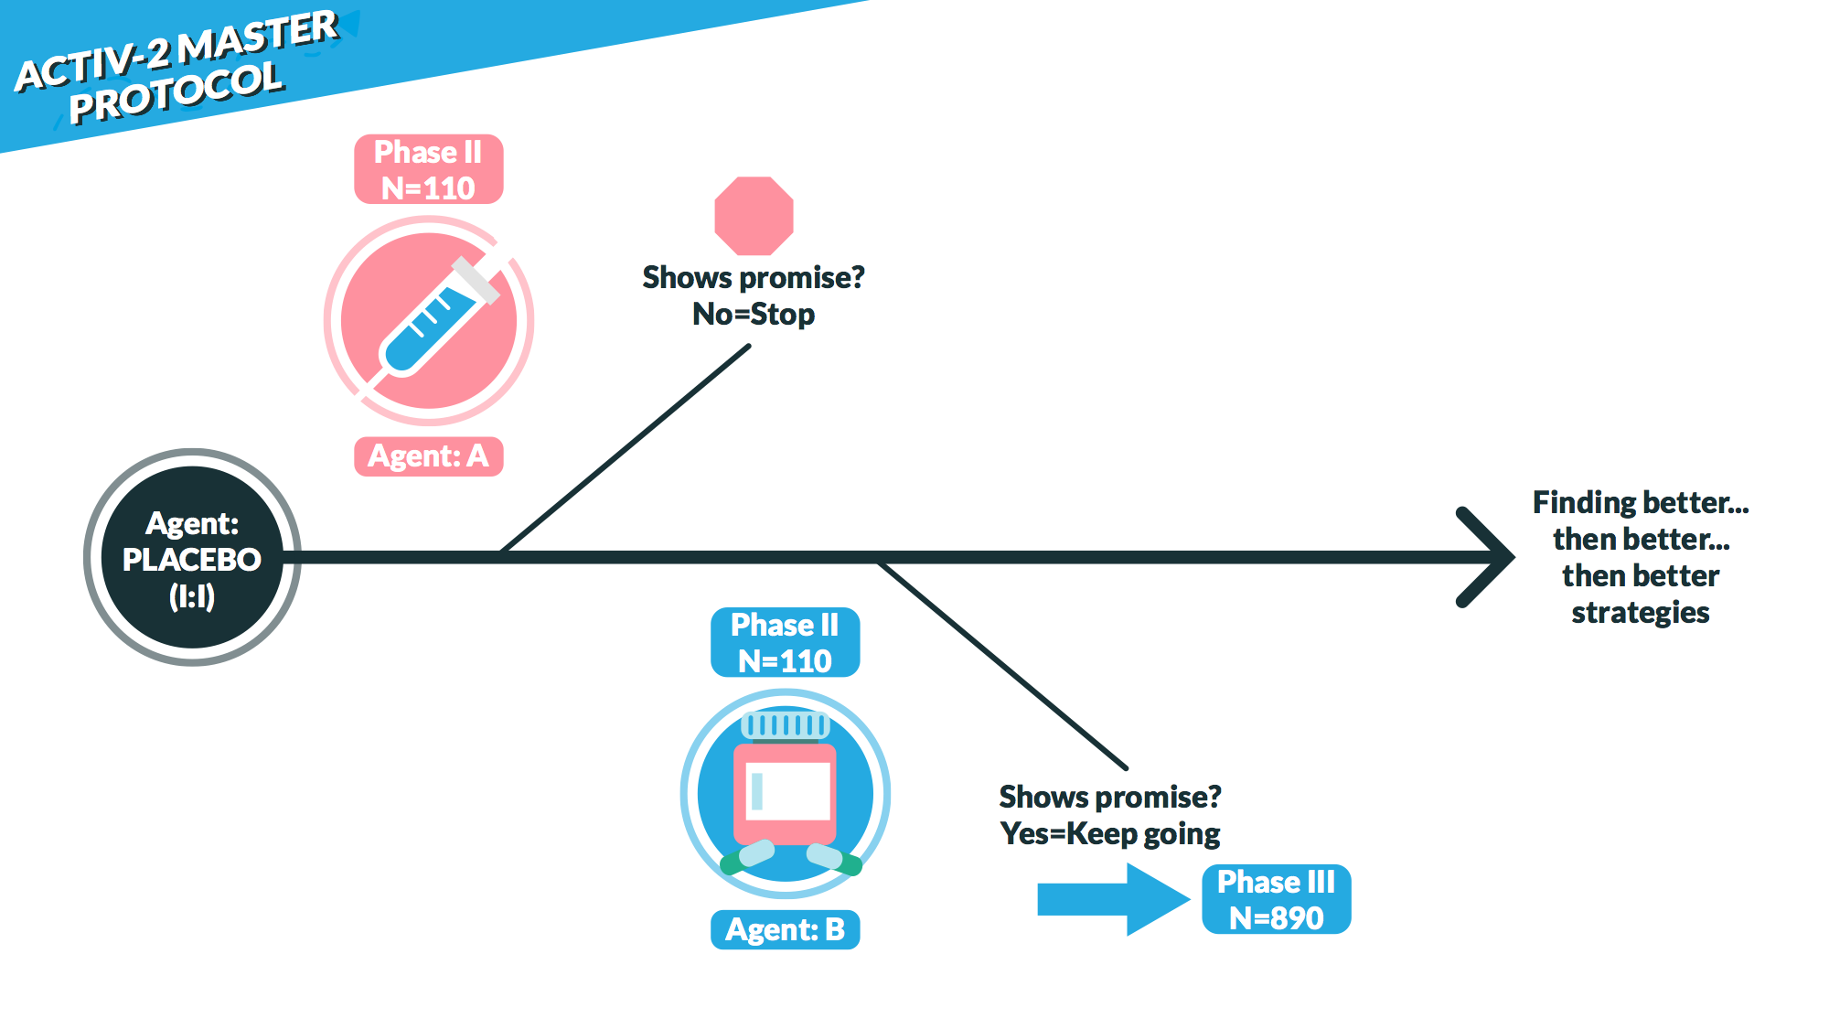

Slide 17
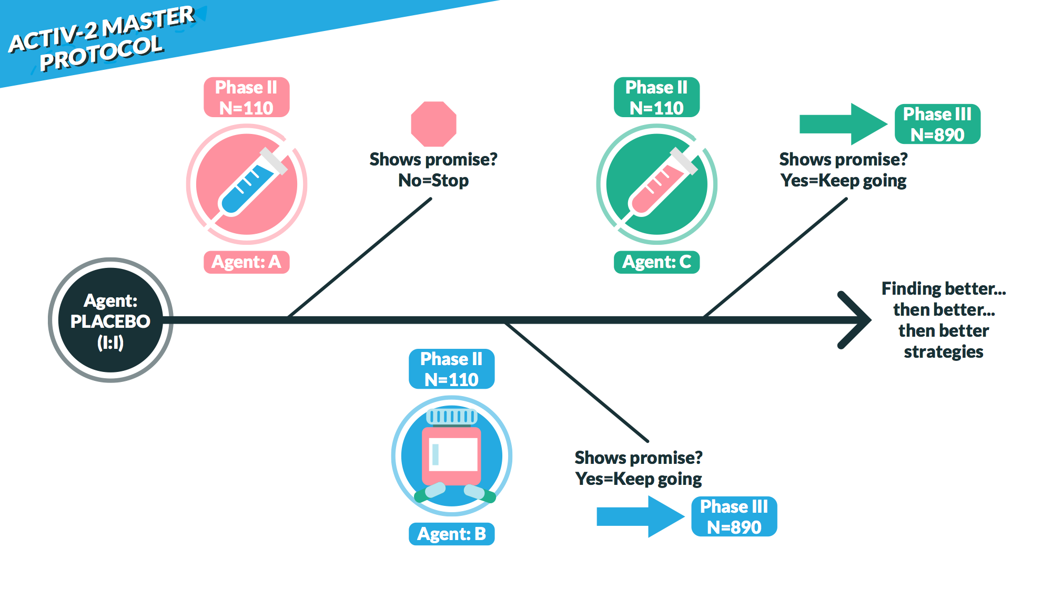

Slide 18


Phase II: 1⁰ Objectives
Determine safety and efficacy of an agent to reduce the duration of COVID-19 symptoms and nasopharyngeal SARS-CoV-2 RNA detection through 28 days after study entry.

Slide 19




Virology: NP Swabs
Proportion negative by ≥20%
Decrease of ≥1 log10 copies/mL
Reduction in median AUC
Symptoms: Diary
Relative reduction of ≥20%
Oxygen saturation: Pulse ox
Proportion oxygen saturation of >=96%
Other considerations:
Safety
Dynamics of virology and symptoms
Viral rebound

Slide 20

Phase III: 1⁰ Objectives
Determine if an agent will prevent either hospitalization or death through 28 days after study entry.

Slide 21

Ambulatory Adult (≥18 years)
Active CoV-2 infection ≤7 days prior to Entry
At least one COVID-19 symptom for ≤10 days prior to Entry, and at least one symptom present <48 hours of entry:
Tailored per study agent
Sx start
Eligible
Not
Days 0 1 2 3 4 5 6 7 8 9 10
CoV-2 Molecular Test +: < 7 days of study entry
At least 1 symptom still present: < 48 hours of study entry

Slide 22
Higher risk of COVID-19 progression:
Age ≥55 years
Co-morbidities (HTN, CVD, DM, chronic kidney, liver or lung disease, obesity (BMI >35)
Time from symptom onset (≤ or >5 days)

Slide 23

Subjective fever
Cough
Shortness of breath or difficulty breathing at rest or with activity
Sore throat
Body pain or muscle pain/aches
Fatigue
Headache
Chills
Nasal obstruction or congestion
Nasal discharge
Nausea
Vomiting
Diarrhea

Slide 24
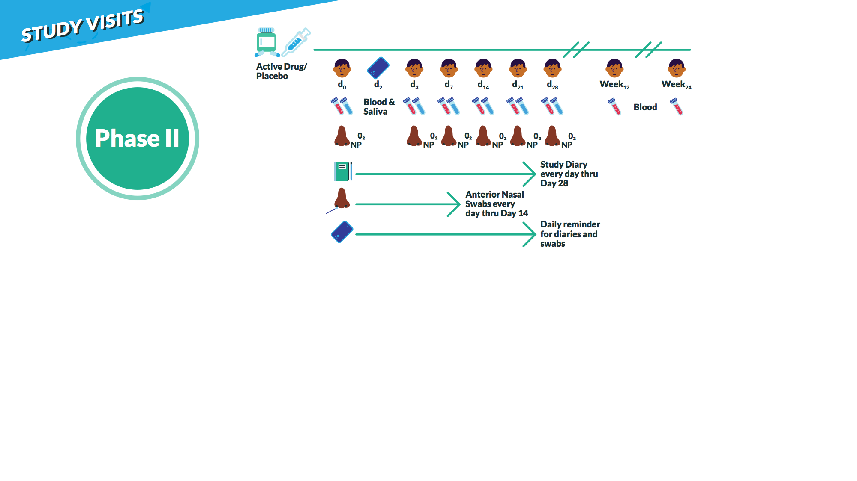

Graduation
Based on symptomatic, oxygenation, or
virologic endpoints

Slide 25
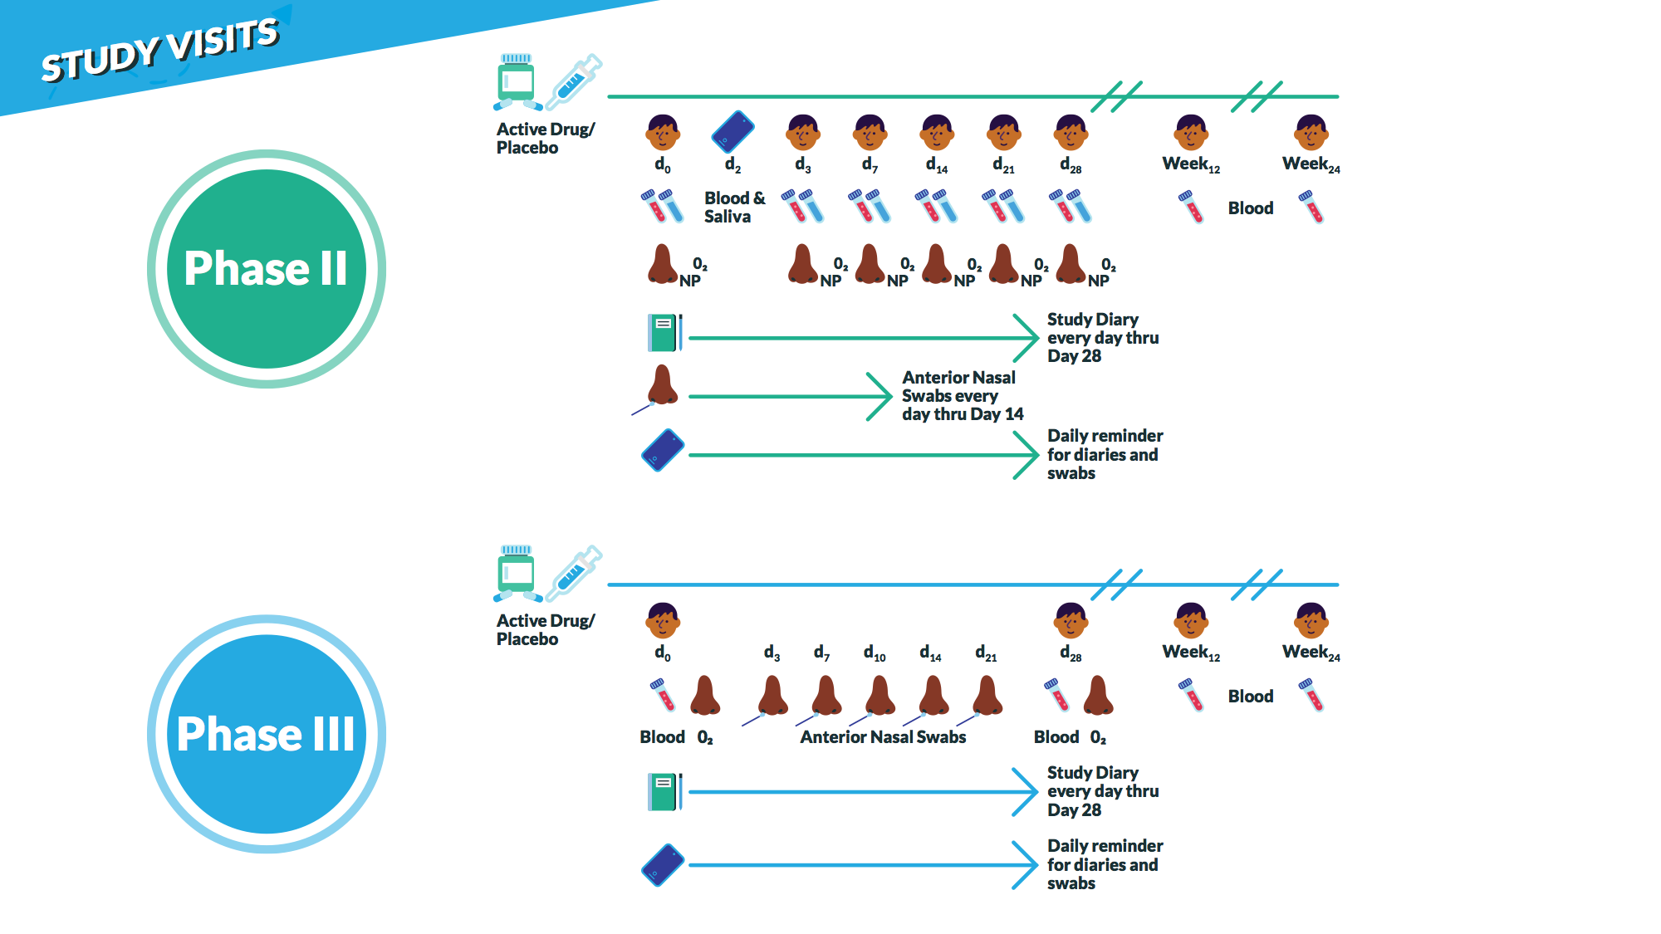
Graduation
Based on symptomatic, oxygenation, or
virologic endpoints

Slide 26
Graduation
Based on symptomatic, oxygenation, or
virologic endpoints
Phase II participants are evaluable for Phase III for an agent that graduates

Slide 27


Slide 28
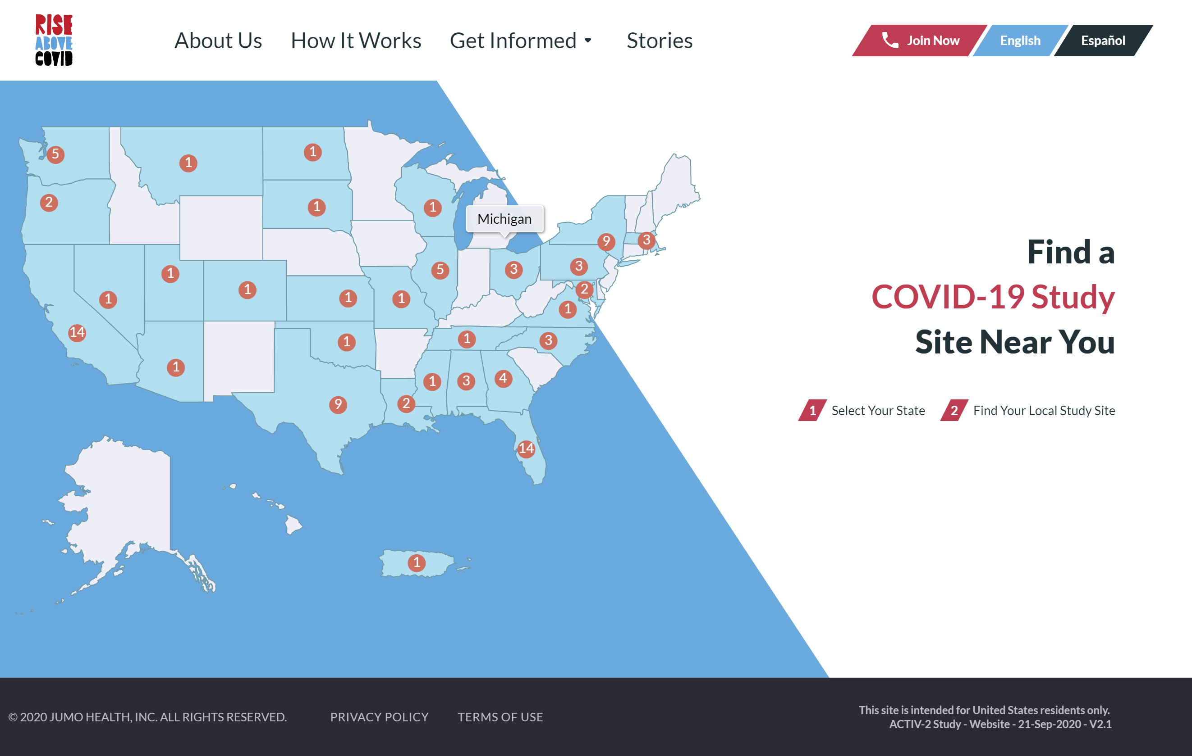
www.riseabovecovid.org

Slide 29
Protocol Chair:
Davey Smith, MD
Protocol Vice Chairs:
Rachel Bender, MD
Kara Chew, MD, MS
Eric Daar, MD
William Fischer, MD
Babafemi Taiwo, MD
David Wohl, MD
DAIDS Clinical Representative:
Arzhang (Cyrus) Javan, MD
Clinical Trials Specialists:
Jhoanna Roa
Lara Hosey
Community Representative:
Jan Kosmyna, MIS, RN, CCRP
Investigators:
Judith Currier, MD, MSc
Joseph Eron, MD
Statisticians:
Michael Hughes, PhD
Carlee Moser, PhD
Justin Ritz, MS
Pharmacologist:
Courtney Fletcher, PharmD
Virologist:
Jonathan Li, MD
Immunologist:
Scott Sieg, PhD

Slide 30



Slide 31
ACTIV-2: REQUIREMENTS FOR REGISTRATION/ACTIVATION

Slide 32
ACTIV-2: REQUIREMENTS FOR REGISTRATION/ACTIVATION
What happens once my site asks to participate?
How long does it take to register?
What are the steps to registration on the part of my site?
Who is my primary point of contact once the trial is enrolling at my site?
Is there a website or other means to track registrations and enrollments?
Who will do the monitoring?
Will I be invited to investigator calls? study coordinator calls?
Will I be invited to co-author papers?
Notes:
What happens once my site asks to (agrees to) participate?
The steps are below. I am not sure how much detail is needed here:
Site expresses interest and signs CDA
Site completed FQ.
If the site responds positively to feasibility, the PPD Concierge CRA will reach out to the site to ask additional outreach/logistical questions.
If qualified, the start-up team and PPD Concierge CRA will contact the site for next steps (CIRB submission, CTA negotiations, PSV/SIV visit, etc.)
How long does it take to register?
5 minutes to complete registration form
What are the steps to registration on the part of my site? On the part if PPD?
The instructions for requesting access and accessing the PSWP are in section 1 of the MOPS.
SECTION 2: ACTG MEMBER WEBSITE INSTRUCTIONS
How to Request an ACTG Member Website Account
Go to https://actgnetwork.org/.
At the bottom of the screen, under Useful Links, click “New Members.”
Fill out the directory update form as much as possible, and click “Submit” when finished.
Please allow up to 5-7 business days for processing.
With whom do I communicate as my site registers when I have questions or concerns? Help link and Support Website or PPD Clinical CRA
Who is my primary point of contact once the trial is enrolling at my site? PPD Clinical CRA
Is there a web site or other means to track registrations and enrollments? Registrations will be tracked through https://actgnetwork.org/ and Enrollment will be tracked through PPD IRT (Interactive Response Technology) with bi-weekly recruitment blasts and monthly Newsletters providing recruitment info
Who will do the monitoring? Clinical CRA
Will I be invited to investigator calls? study coordinator calls? Yes, right now there is a joint Investigator/Study Coordinator call on Thursdays 5:00 pm est.
Will I be invited to co-author papers? Any request for publications will need to be submitted/approved by the ACTG
Discuss pharmacy requirement
Site Requirements/Pharmacy Requirements will be part of the feasibility process and discussed in detail prior to site activation

Slide 33
ACTIV-2: REGISTRATION/ACTIVATION
Notes:
Once your site is active you will have access to additional information at the ACTG website, this slide walks through how you can register.

Slide 34
ACTIV-2: INFORMATION SECURITY & PRIVACY
Required Reviews/Approvals of Platforms
Preliminary Information Security Officer/Privacy Officer review required prior to commercial IRB submission (link for more details).
Centralized Information Security Review by Research Support Division
Satisfies the preliminary ISO review
VA CSP Perry Point will collect & submit to RSD for review
RSD executes central review, issues report for VAMCs
Final ISO/PO approvals by sites are needed to ensure safe handling and storage of Veteran data.

Slide 35
ACTIV-2: REQUIRED REVIEWS
Advarra is the Commercial single IRB (sIRB)
**No local IRB review needed**
Requires site reliance agreement with Advarra; wise to develop local SOPs
Advarra must be included on site’s FWA
Help is available from the ORD Office of Research Policy, Protections & Education; Contact IRBRelianceandSIRBExceptions@va.gov
Template VA adapted informed consents provided
Advarra average approval time ≈ 3-5 days
Local R&DC Review
Ensure R&DCs’ SOPs allow for ad hoc reviews
Prepare your R&DC for the fast-paced registration requirements for this prioritized critical trial
Identify rate-limiting factors and discuss these with your ACTIV-2 registration team.

Slide 36
PHARMACY REQUIREMENTS
Notes:
The requirements are part of the feasibility and site qualification process.

Slide 37
PHARMACY REQUIREMENTS
Pharmacy / Pharmacy Staff Credentials:
  Licensed Pharmacist
  Back up pharmacist is recommended
Acceptable equipment for the IP:
  Functional pharmacy sink, refrigerated storage, freezer storage, temperature monitoring system with back-up, alarm system for notification to authorized personnel of temperature deviations/excursions in place
Prep of IP Space Requirements:
  Dedicated Pharmacy
  Prep room -USP 797 (per protocol)
  BSC protocol requirement
    If a biosafety cabinet or isolator is not available, a laminar flow hood may be used.

Slide 38
FUNDING CONSIDERATIONS
Notes:
NPC will have to enter into the contract.

Slide 39
FUNDING CONSIDERATIONS
It’s important to understand that funding for this protocol is coming from outside the VA
NPCs will need to be responsible for the revenue stream, so sites need to be aware of these requirements for staffing/equipment purposes

Slide 40

LESSONS LEARNED & TIPS FOR WARP SPEED
Create a Project Plan
Communicate
Designate Personnel
ID the Order of Operations
Anticipate Hurdles
Sound the Alarm—ASK FOR HELP
“Measure Twice, Cut Once”
Attend Calls & Meetings
Embrace Efficiencies
Think Outside the Box
Delegate a POC
Be Flexible

Slide 41
HELP AND RESOURCES

Slide 42
HELP AND RESOURCES
Facilities (tents/pods)
  DaidscrssFacilityRequestactiv2a5401@ppdi.com
Equipment/Supplies/Short term staffing needs/Laboratory Diagnostics (POC)
  ACTIV2EquipmentRequest.sm@ppdi.com
Participant Transportation
  Ride Health Ryan Boulier (ryan@ridehealth.com)
Home Health
  Cindy Wood (cindy.wood@patientprimary.com)
Advertising Campaign
  PPD Clinical Team managers at (daidscrssclinicalactiv2a5401@ppdi.com)

Slide 43
HELP AND RESOURCES
Any questions may go to Leslie Smith, Director Project Delivery (leslie.smith@ppdi.com)
In addition:
  Medical management questions, investigational drug/study drug use questions, SAE questions and reports may go to Dr. John Sanders, PPD Medical Monitor (John.Sanders2@ppdi.com) and PPD PVG Sara Cunningham, Lead Medical Project Coordinator (Sara.Cunningham@ppdi.com)
  Site funding questions to concierge CRA assigned to your site
  Pharmacy questions to Unblinded Clinical Team Karen Hufham (Karen.Hufham@ppdi.com)
ORD questions—on other ACTIV/OWS studies, policy, local barriers to COVID-19 research—email ORDCOVID19@va.gov

Slide 44
HELP AND RESOURCES
Interest in Participation: Contact: Donna.Kostandy@ppd.com
ORD questions—on other ACTIV/OWS studies, policy, local barriers to COVID-19 research—email ORDCOVID19@va.gov

Slide 45
SUMMARY
Why ACTIV-2?
Promise: perhaps, treatments for COVID-19
Contribution: to the global effort
Access: for Veterans
Efficiency: multiple investigational agents will be tested
Opportunity: for VA researchers—publications, access to data and biospecimens
Capability: VA has experience in multicenter clinical trials
Challenge: of a master, adaptive, platform protocol

Slide 46

THANK YOU AND QUESTIONS
For additional information:
Email ORD
ORDCOVID19@va.gov
Website for OWS https://www.hhs.gov/about/news/2020/06/16/fact-sheet-explaining-operation-warp-speed.html
Website for ACTIV https://www.nih.gov/research-training/medical-research-initiatives/activ

Slide 47
AVAILABILITY OF RECORDING
A recording of this session and the associated handouts will be available on ORPP&E’s Education and Training website approximately one-week post-webinar
An archive of all ORPP&E-hosted webinars can be found here: https://www.research.va.gov/programs/orppe/education/webinars/archives.cfm

